Slide 1



Chapter 5 Link Layer
Computer Networking: A Top Down Approach 6th edition Jim Kurose, Keith Ross Addison-Wesley March 2012
A note on the use of these ppt slides:
We’re making these slides freely available to all (faculty, students, readers). They’re in PowerPoint form so you see the animations; and can add, modify, and delete slides (including this one) and slide content to suit your needs. They obviously represent a lot of work on our part. In return for use, we only ask the following:
If you use these slides (e.g., in a class) that you mention their source (after all, we’d like people to use our book!)
If you post any slides on a www site, that you note that they are adapted from (or perhaps identical to) our slides, and note our copyright of this material.
Thanks and enjoy! JFK/KWR
All material copyright 1996-2012
J.F Kurose and K.W. Ross, All Rights Reserved

Slide 2
Link layer, LANs: outline
5.1 introduction, services
5.2 error detection, correction
5.3 multiple access protocols
5.4 LANs
addressing, ARP
Ethernet
switches
VLANS
5.5 link virtualization: MPLS
5.6 data center networking
5.7 a day in the life of a web request

Slide 3
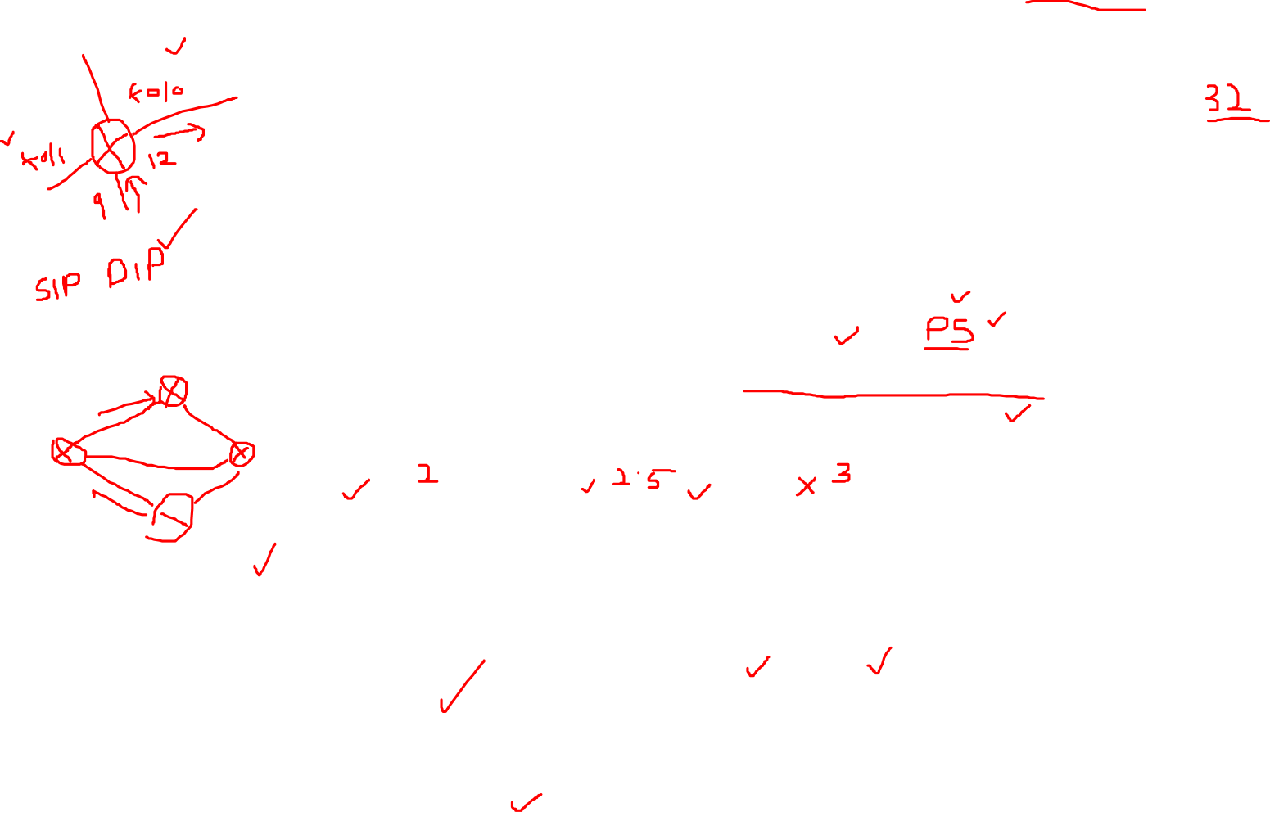
Multiprotocol label switching (MPLS)
initial goal: high-speed IP forwarding using fixed length label (instead of IP address)
fast lookup using fixed length identifier (rather than shortest prefix matching)
borrowing ideas from Virtual Circuit (VC) approach
but IP datagram still keeps IP address!
PPP or Ethernet
header
IP header
remainder of link-layer frame
MPLS header
label
Exp
S
TTL
20
3
1
5

Slide 4

MPLS capable routers
a.k.a. label-switched router
forward packets to outgoing interface based only on label value (don’t inspect IP address)
MPLS forwarding table distinct from IP forwarding tables
flexibility: MPLS forwarding decisions can differ from those of IP
use destination and source addresses to route flows to same destination differently (traffic engineering)
re-route flows quickly if link fails: pre-computed backup paths (useful for VoIP)

Slide 5

MPLS versus IP paths
R6
D
R4
R3
R5
A
R2
IP routing: path to destination determined by destination address alone
IP router

Slide 6

MPLS versus IP paths
entry router (R4) can use different MPLS routes to A based, e.g., on source address
R6
D
R4
R3
R5
A
R2
IP routing: path to destination determined by destination address alone
IP-only
router
MPLS routing: path to destination can be based on source and dest. address
fast reroute: precompute backup routes in case of link failure
MPLS and
IP router

Slide 7

MPLS signaling
modify OSPF, IS-IS link-state flooding protocols to carry info used by MPLS routing,
e.g., link bandwidth, amount of “reserved” link bandwidth
entry MPLS router uses RSVP-TE signaling protocol to set up MPLS forwarding at downstream routers
R6
RSVP-TE
D
R4
R5
modified
link state
flooding
A

Slide 8
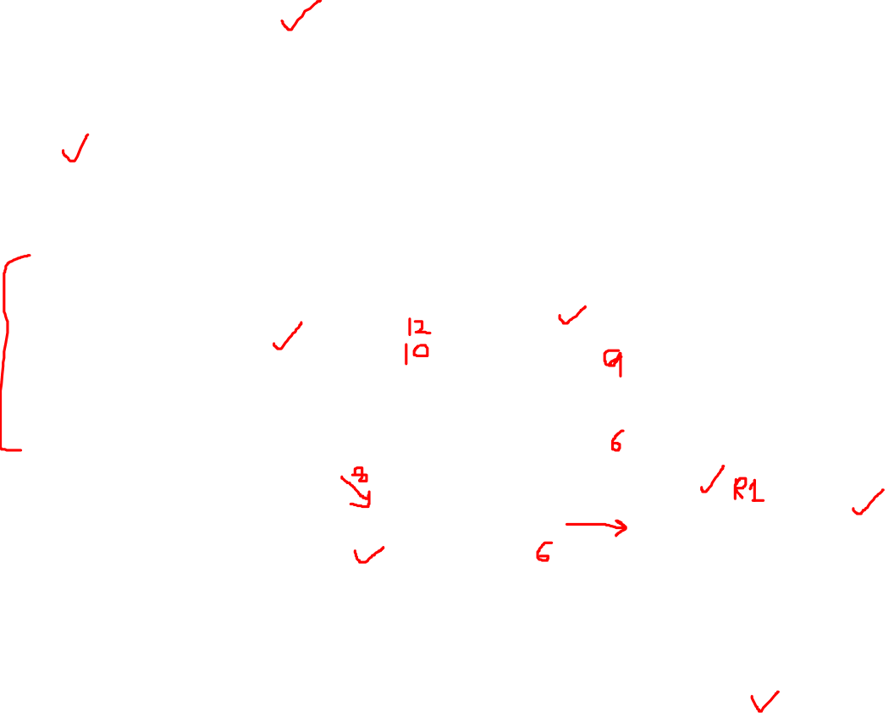
MPLS forwarding tables
in out out
label label dest interface
10 A 0
in out out
label label dest interface
12 D 0
8 A 1
10 6 A 1
12 9 D 0
R6
0
0
D
1
1
R4
R3
R5
0
0
A
R2
in out out
label label dest interface
R1
in out out
label label dest interface
6 - A 0
8 6 A 0

Slide 9

Chapter 5: Summary
principles behind data link layer services:
error detection, correction
sharing a broadcast channel: multiple access
link layer addressing
instantiation and implementation of various link layer technologies
Ethernet
switched LANS, VLANs
virtualized networks as a link layer: MPLS

